Slide 2
Michael Hopkins
Master Builders ACT, CEO

Slide 3
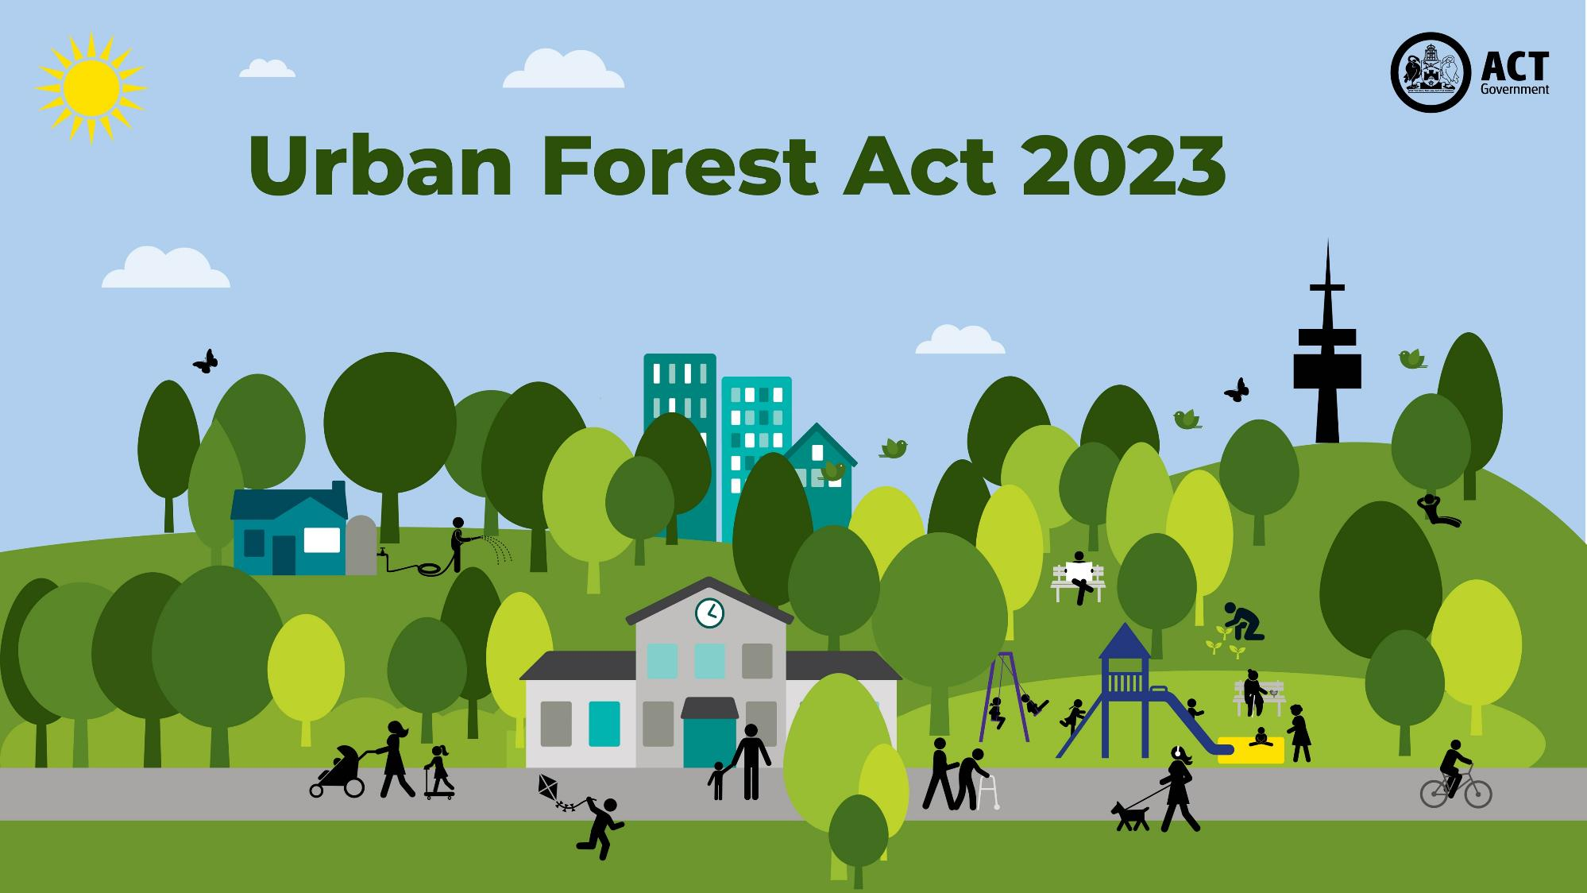
Transport Canberra
and City Services

Slide 4
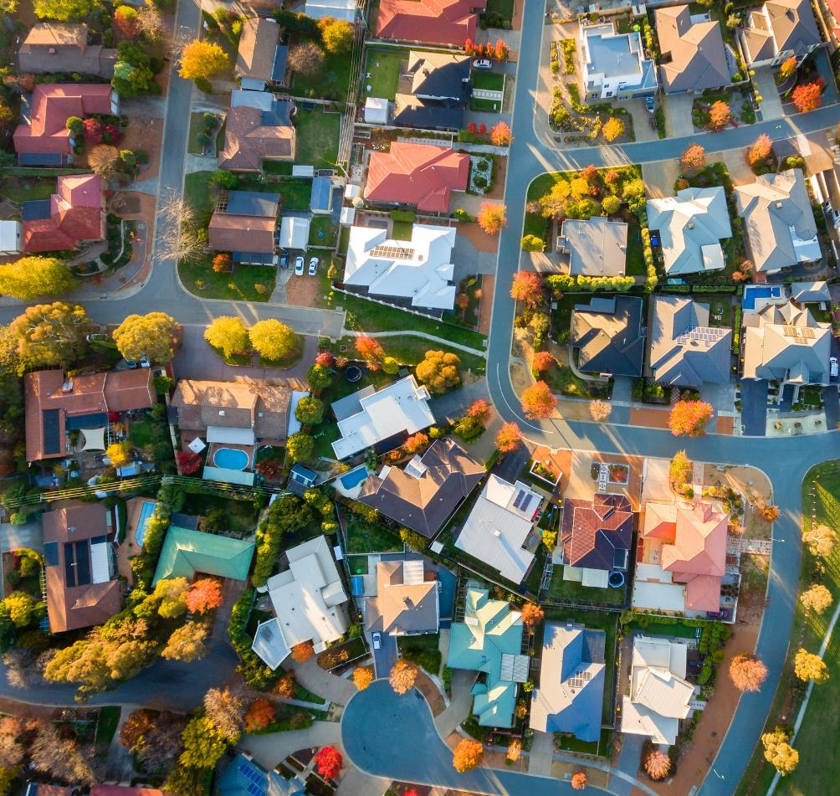
In our Urban Forest Strategy, we set out a roadmap to achieving a target of 30% canopy cover across Canberra’s urban footprint by 2045.
The new laws will help achieve the canopy cover target by:
providing increased protection to more trees
ensuring when trees are removed, they are replaced.
Notes:
Underpinning the new Act is our ambitious target to achieve 30% per cent tree canopy cover or equivalent by 2045.
We set out a roadmap to achieving a target of 30% canopy cover across Canberra’s urban footprint by 2045 in our Urban Forest Strategy 2021-2024.
That strategy was developed in the context of the ACT Planning Strategy, ACT Climate Change Strategy and the Living Infrastructure Plan. Getting the balance right between urban densification and tree protection is critical if we want to maintain our bush capital identity and face the challenges that our changing climate will bring.
The new Urban Forest Act and associated laws will help us achieve this canopy cover target by:
providing increased protection to more trees
ensuring that when trees are removed, they are replaced.

Slide 5
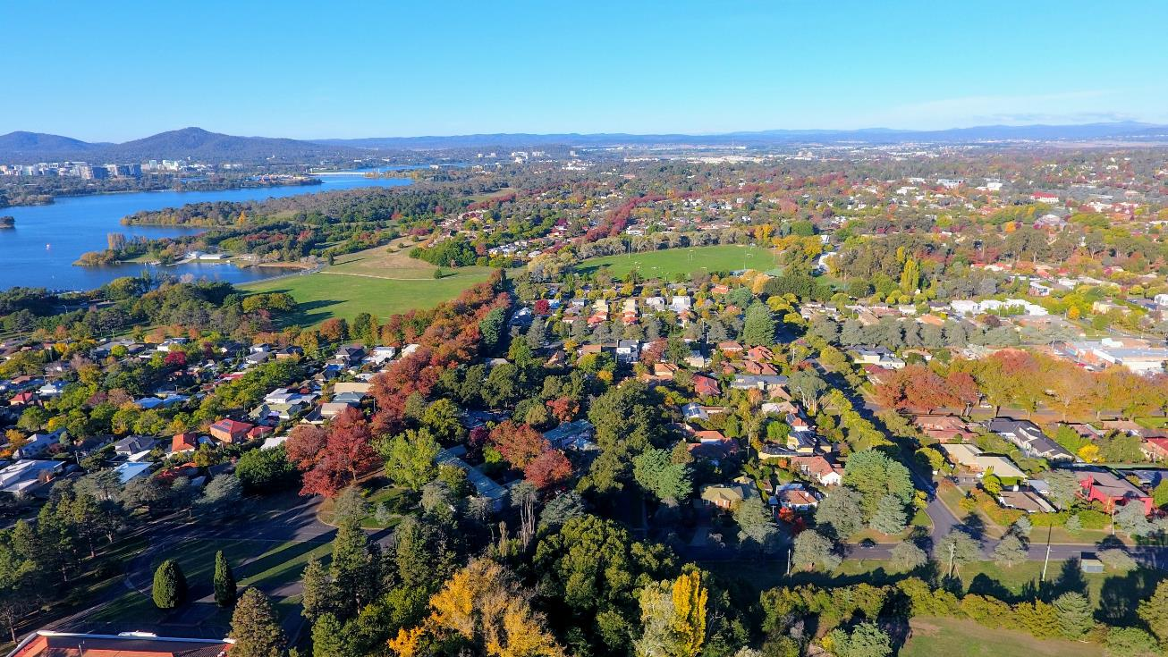
The new laws protect more trees by:
classifying all trees on public land as protected
reducing the size requirements for protected trees on private land
protecting dead native trees that provide essential habitat elements for local fauna
Expanding the ACT Tree Register which celebrates and protects our most significant trees.
On 1 January 2024, the Urban Forest Act 2023 replaced the Tree Protection Act 2005.
Notes:
The Urban Forest Act 2023 came into effect on 1 Jan 2024, replacing the Tree Protection Act 2005.
Why did we review the Tree Protection Act and what was the process?
There have been environmental and policy changes since Tree Protection Act 2005 which include the Urban Forest Strategy, Climate Change Strategy and the Infrastructure Plan.
As a result, we undertook consultation with industry and community on draft Urban Forest Strategy in mid 2020.
We then undertook consultation on the Draft Bill 21 April – 2 June 2021.
We held a Standing Committee on Planning, Transport and City Service inquiry on 12 August 2022. Multiple recommendations made and the Bill was then accepted by Government making it a new Act.
The benefits of the new Urban Forest Act:
It supports the ACT Government target to achieve 30% canopy cover to keep Canberra a liveable city amidst growing climate risks including urban heat, in line with the Urban Forest Strategy
It ensures consistent protection measures across public and private trees
It also aligns more closely with other jurisdictions across Australia in terms of size of protected trees, bonds and a contributions framework for when trees are removed.
What does the new legislation include?
A new definition for protected trees
It increases protection of trees by reducing the size of protected trees on leased/private land
It also ensures all public trees are now protected trees, irrespective of size
A new Canopy Contribution Framework
This framework aims to increase our city’s canopy cover by requiring Canberrans to:
retain protected trees wherever possible
replant where retaining a protected tree is not possible, or
pay a contribution where replanting is not possible, to support canopy cover elsewhere.

Slide 6
Urban Forest Act – What else has changed?
Mandating tree management plans in application processes for activities that may impact a protected tree, e.g. driveway, building, and public land use applications.
Mandating the inclusion of tree management plans in all development applications where a protected tree may be impacted.
Introducing tree bonds to ensure protected trees are not damaged during construction work.
Introducing canopy contribution agreements to replace lost canopy when a protected tree is approved for removal.
Increasing penalties for people caught damaging a protected tree or breaching a Tree Management Plan or direction.
Notes:
The legislation will also:
Mandate the inclusion of Tree Management Plans in all Development Applications where a protected tree may be impacted
Mandate Tree Management Plans where a protected tree may be impacted in any case, e.g. Driveways, Building Applications, public events
Introduce tree bonds to ensure protected trees are not damaged during construction work
Increase penalties for people caught damaging a protected tree or breaching a Tree Management Plan or direction
Expand the ACT Tree Register
We will expand on a number of these points in the following slides but in short, we expect this new legislation to more than double the number of protected trees on private land in the ACT.
Every tree in Canberra – both on public and private land – is part of an urban forest.
The new laws have been developed to encourage a shared care approach by the ACT Government as well as industry and the community, to ensure collectively, we protect the forest that protects us.

Slide 7
What is a tree?
A tree can be:
a woody perennial plant (excluding bamboo)
a plant resembling a tree in form and size
any other plant prescribed by legislation (such as a palm tree).
Hedge plants will be classified as trees under the Act if they are unmaintained hedges that have grown into trees that meet regulated size requirements.
Hedge plants will not be classified as trees under the Act if the original intent of the planting was for the purpose of a hedge and the plantings are maintained as a hedge.
Notes:
A tree can be:
a woody perennial plant (excluding bamboo)
a plant resembling a tree in form and size
any other plant prescribed by legislation (such as a palm tree).
Hedge plants will be classified as trees under the Act if they are unmaintained hedges that have grown into trees that meet regulated size requirements.
Hedge plants will not be classified as trees under the Act if the original intent of the planting was for the purpose of a hedge and the plantings are maintained as a hedge.
If a hedge plant has been assessed as a tree and approved for removal, the applicant may meet their canopy contribution replanting requirement by planting replacement hedging, in keeping with the original intent of the plantings.

Slide 8
Protected trees – a new definition
A tree on private land is a protected tree if it: ​
is 8m or taller ​
has a canopy 8m or wider ​
has a trunk circumference of 1m or more at 1.4m above natural ground level ​
is a dead native tree that has a trunk circumference of 1.88m or more at 1.4m above natural ground level​
was planted as part of a canopy contribution agreement in the last 5 years
All trees on public land are protected trees.
All registered trees are protected trees.
Notes:
Under the Urban Forest Act 2023, protected trees fall under three categories: ‘regulated’, ‘registered’ or ‘public’.
Regulated trees are living and dead native trees on private land that meet certain size criteria.
Registered trees are trees of exceptional value on either private or public land that are listed on the ACT Tree Register.
Public trees are all trees on public land, regardless of their size, location and who planted the tree.
With the new legislation a tree on private land is a protected tree if it:
Is 8m or taller ​
has a canopy 8m or wider ​
has a trunk circumference of 1m or more at 1.4m above natural ground level ​
is a dead native tree that has a trunk circumference of 1.88m or more at 1.4m above natural ground level​
was planted through the Canopy Contribution Agreement in the last 5 years (and we will talk about Canopy Contribution Framework in some later slides)
Protection of trees in the ACT is now covered by one piece of legislation – not two.
Trees on rural leases are not covered by the legislation.
Canberrans will be encouraged to consider tree maintenance and protection measures to encourage retention of existing trees.
When a tree is approved for removal on private property, homeowners will be required to plant two replacement trees on their block or, if planting new trees is not feasible, pay a set $600 contribution per unplanted replacement. Non-homeowners will be required to replant or pay a determined contribution depending on tree size and land zoning.

Slide 9
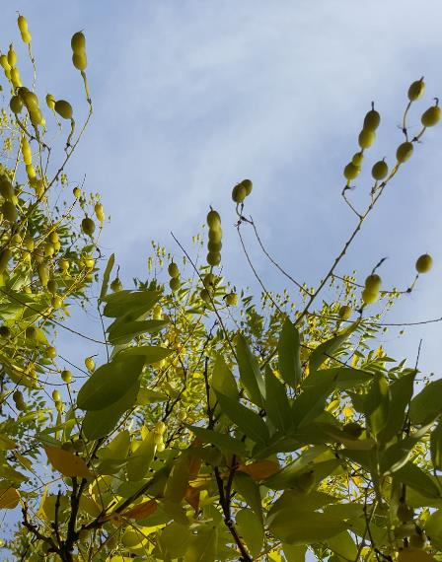
Protected tree work permissions
You must have permission from the ACT Government to undertake any work that may affect a protected tree.
If the tree activity relates to an activity requiring another form of approval such as a development, building or driveway application, permission can be sought:
through a tree activity application submitted prior to undertaking the other application process, or
during the other application process in conjunction with a tree management plan.
Notes:
You must have permission from the ACT Government to undertake any work that will affect a protected tree.
If the tree activity relates to an activity requiring another form of approval such as a development, building or driveway application, permission can be sought:
through a Tree Activity Application submitted prior to undertaking the other application process, or
during the other application process in conjunction with a Tree Management Plan.
Each application is assessed on merit and is dependent on the individual tree and circumstance.

Slide 10
Tree activity applications
Any person or entity can complete an online tree activity application if they plan to undertake any works on a protected tree or undertake work within its tree protection zone.
Works include:
tree removal
tree pruning
utility maintenance or installation
building or landscape construction
Applications need:
tree owner written consent (the leaseholder of the land)
details of the activity the applicant intends to undertake
Applicants may need to submit a shadow diagram, pruning plan and/or a tree management plan.
Instructions on obtaining appropriate consent from clients is available on the website.
Notes:
Any person or entity can complete an online Tree Activity Application. You can complete it for your client but will need their written consent. Alternatively, they can complete it themselves.
a Tree Activity Application must be approved before any work can be undertaken on a protected tree or within the Tree Protection Zone of any protected tree.
For registered trees on private land, approval is required for any work – even minor pruning.
If you are a contractor, such as an arborist or builder, and you are applying on your client’s behalf, you must provide:
detail on the activity you are applying to undertake,
written consent from the client to undertake the work, and
written consent from the client to submit the application.
All 3 requirements for the application can be met by attaching one of the following:
an Acknowledgement of Consent form completed by the tree/landowner
an email from your client (attached as a screenshot or copy), or
a quote provided by you to the client and signed by the client.
Instructions on obtaining appropriate consent from clients is available on our website
The assessment of Tree Activity Applications can take up to 35 working days. The processing time may be extended if applicants do not provide all information required.
There is no cost associated with submitting a Tree Activity Application.
Some applicants may also need to submit a shadow diagram, pruning plan or/and a Tree Management Plan.

Slide 11
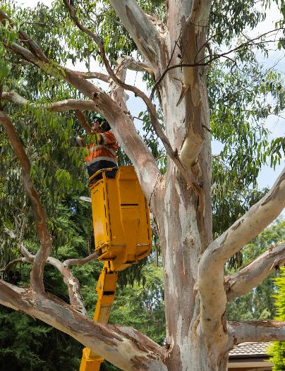
Development applications
ACT Government processes, such as development, building or driveway applications, must now include a:
tree management plan (where protected trees may be impacted).
Approved processes may result in a:
canopy contribution agreement (for trees which have been approved for removal).
bond agreement (for trees being retained).
Notes:
All Development Applications and driveway and building applications that could potentially impact on a protected tree must now include a Tree Management Plan.
Both public and protected private trees can be shown on the same Tree Management Plan.
Applicants would be permitted to commence works on or within the Tree Protection Zone only after receipt of:
a signed Canopy Contribution Agreement (for trees which are being removed), and/or
an approved Tree Management Plan and, if applicable, a Bond Agreement (for trees which are being retained).
Tree Management Plans submitted as part of a Development Application will be assessed during the statutory timeframes for the Development Application process.
We will be monitoring the timeliness of new processes as we implement them so that we can identify potential issues.
Tree Management Plans may be used to identify trees requiring bonds, to ensure trees are valued and protected from nearby construction works so they can continue providing benefits to the surrounding community and enhance the value of the project
Where there are trees requiring bonds, the applicant will be required to enter into a bond agreement and pay a bond.
Prior to the establishment of a bond agreement, the applicant will need to supply an initial condition report of the tree.
The minimum bond amount will be the calculated benefit of the tree canopy or $3,000 (whichever is greater). The maximum amount will be three times the calculated benefit (for exceptional trees and trees at high risk of damage).

Slide 12
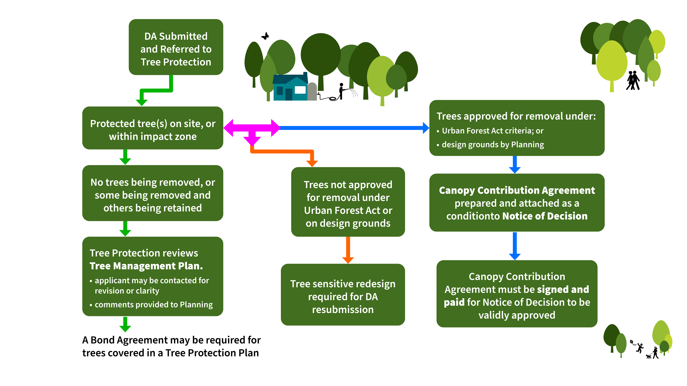
Development application process
Notes:
This flowchart provides a summary of the pathways that your Development Application may take in relation to the Urban Forest Act requirements.
If the site has no protected trees on it, or adjacent to it, that may be impacted by the proposed development, the Tree Protection Unit will return your DA to the planning team with cleared comments.
If your site has protected trees on it, or adjacent to it, that may be impacted by the proposed development your application may take a few different paths. 1. if you are not planning to remove any of the protected trees, or you are intending to retain some but not all protected trees, your Tree Management Plan will be reviewed. This may involve the tree team contacting you or the arborist who prepared the report to seek revisions or further detail. Under the Tree Management Plan Guidelines (specifications) an incomplete or noncompliant TMP may be returned to the applicant for revision. 2. if you are applying to remove some or all protected trees, your application will be assessed against the Urban Forest Act criteria for removal. If this is not approved, Planning may approve removal on design grounds. Design ground approval is not guaranteed. If approval is granted by Tree Protection or by Planning, your Notice of Decision on your DA will include a condition that a Canopy Contribution Agreement must be entered into. 3. If your application to remove protected trees is denied by both Tree Protection and Planning, you will be required to use tree sensitive measures in your redesign.
4. If your application to remove a tree is denied, but does not impact your development plans and you proceed, you may be required to revise your Tree Management Plan to ensure protection measures are included for the retained tree.

Slide 13
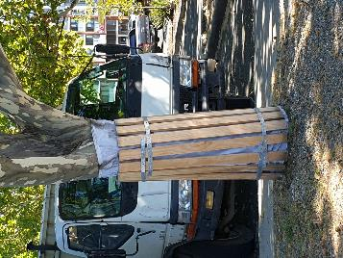
Tree management plans
A Tree Management Plan (TMP) outlines protection measures to prevent damage occurring to a protected tree during works or access occurring in the tree protection zone.
TMPs will be mandatory for:
any work in a tree protection zone
all development applications with protected trees on leased land or adjacent to leased/unleased land
driveway or building applications that may impact a public tree.
Notes:
A Tree Management Plan is a mandatory document for all Development Applications and for driveway and building applications that may impact a protected tree.
The Tree Management Plan will provide a summary of the protected trees covered by the plan and outline the protection and maintenance measures that are required to be followed to best maintain their health .
The Tree Management Plan must comply with new legislated specifications for Tree Management Plans, known as the Tree Management Plan Guidelines (Specifications).
An approved Tree Management Plan provides ongoing approval for management techniques used to protect trees from activities or groundwork in a Tree Protection Zone.
A decision will be made on a Tree Management Plans within 40 working days of submitting an application, unless submitted as part of a Development Application. If the Tree Management Plan is submitted as part of a Development Application, it will be assessed during the statutory timeframes for the Development Application process.
A Tree Management Plan takes effect on the date it is approved, unless otherwise specified.

Slide 14
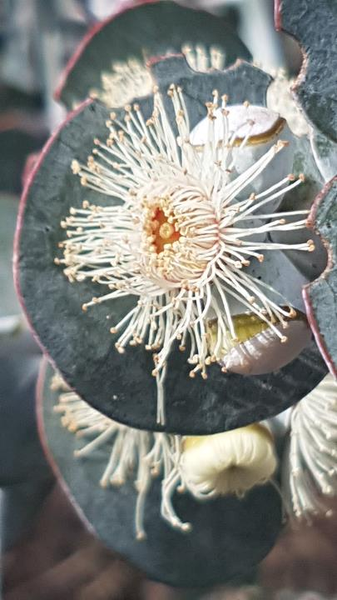
Tree management plans
There are different requirements for TMPs depending on the complexity of the project and level of expected impact on the trees and their tree protection zone.
No/low impact – can be completed by a homeowner.
Moderate/high impact – may be completed by a certified project arborist or equivalent.
If your project requires a tree management plan, it must comply with legislated Tree Management Plan Guidelines.
Notes:
No impact – activity is near the protected tree, but all activity is outside the protection zone and not on public land.
For example, vehicle access to the construction site outside of the TPZ and not via the nature strip.
This would require a signed declaration or email from the lessee of the land and a high level site plan indicating appropriate fencing of the TPZ.
Note that any activity on public land will require approval from TCCS and a public unleased land permit may also be required.
Low impact – activity in a TPZ with encroachment of 20% or less. No construction in the TPZ (for example, storage of small equipment or excavation for pavement or trenchless irrigation)
Will need a TMP outlining TPZ fencing, proposed encroachment and protection measures for protected trees.
The TMP much be developed in accordance with guidelines and approved before work starts.
Mod to high impact – TPZ with encroachment greater than 20% and/or groundwork within the TPZ, contact of any kind with the protected tree and/or modifications to the TPZ during the project. (for example, machinery or vehicle access, erection of scaffolding or crane, storage of large machinery, cut and fill exceeding 100mm)
TMP may be prepared by a project arborist or equivalent and approved before work starts.

Slide 15
Landscape Management and Protection Plans (LMPPs)
LMPPs outline the protection and management of Territory assets such as footpaths, stormwater sumps, kerb and gutter and public lighting.
Tree Management Plans (TMPs) outline the protection and management measures for protected trees. A TMP may (and is preferred to) be prepared that includes both public and leased land (regulated) trees.
So where a LMPP is required and there are trees on the verge, you need to attach your TMP to your LMPP application.
Where appropriate the same plan can be used for both an LMPP and TMP provided it adequately protects all assets and trees on the verge.
Notes:
For works that are restricted to public land only, or where there are no protected trees on the affected leased land, the applicant may opt to include public trees on a single plan. If this is done, the plan must be duplicated, labelled as such and submitted individually against the LMPP and TMP requirement.

Slide 16
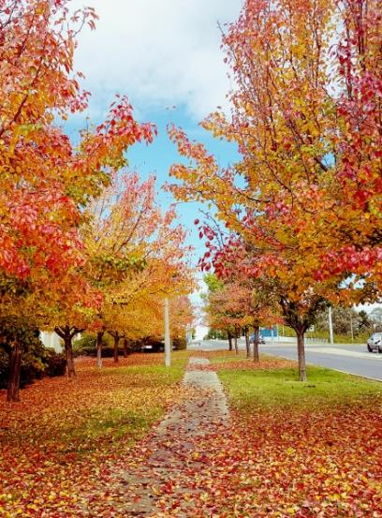
Canopy contribution agreements
When a protected tree is approved for removal, a canopy contribution agreement is required.
The agreement sets out:
how many replacement trees are to be planted on the block to replace those removed, or
when planting is not an option, what financial contribution is required to support the urban forest.
Notes:
If it is not possible to retain trees, replanting of trees on the block is prioritised over a financial contribution where replanting onsite is practical, reasonable, and appropriate.
This Framework is a mechanism to ensure that where trees are approved for removal, they are replaced through replanting or paying an offset financial contribution.
Anyone who received approval to remove a protection tree must enter a Canopy Contribution Agreement.
Prior to removal, applicants will be required to enter a Canopy Contribution Agreement that outlines their contribution terms.
An approved Notice of Decision to remove a protected tree remains conditional until a Canopy Contribution Agreement has been signed and paid.
There will be separate conditions for homeowners and non-homeowners.
For homeowners who gain approval to remove a protected tree, for every tree that is removed two new trees must be planted or a payment of $600 will apply for each tree not planted, to a maximum of $1,200 per removed tree.
Non-homeowners, such as developers or builders, who gain approval to remove a protected tree will have differing replanting or financial contribution requirements. Contributions will vary depending on the size of the tree or trees and the zoning of the site which they are located on. These figures are calculated using the tree calculator which will be available for public use.
For homeowners, exemptions may be granted, including for people who are experiencing financial or social hardship.
The financial contribution to the Canopy Contribution Agreements will fund tree planting, maintenance and renewal activities throughout Canberra.

Slide 17
Canopy contribution agreements
For homeowners, the replanting requirements or financial contribution will be a set rate of:
two trees for every single tree removed, or
$600 for each tree not replanted.
For non-homeowners, the replanting requirements or financial contributions will depend on the size and location of the tree/s to be removed.
Notes:
Anyone who received approval to remove a protection tree must enter a Canopy Contribution Agreement. For homeowners who gain approval to remove a protected tree, for every tree that is removed two new trees must be planted or a payment of $600 will apply for each tree not planted, to a maximum of $1,200 per removed tree.
Non-homeowners, such as developers or builders, who gain approval to remove a protected tree will have differing replanting or financial contribution requirements. Contributions will vary depending on the size of the tree or trees and the zoning of the site which they are located on. These figures are calculated using the tree calculator which will be available for public use.
For homeowners, exemptions may be granted, including for people who are experiencing financial or social hardship.
The financial contribution to the Canopy Contribution Agreements will fund tree planting, maintenance and renewal activities throughout Canberra.

Slide 18
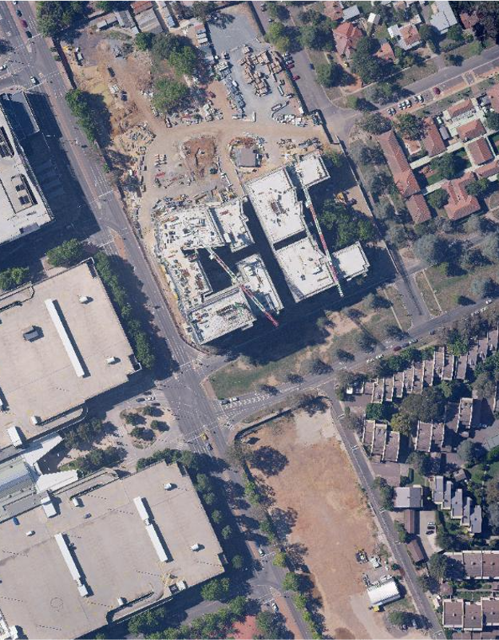
Tree calculator
A new online calculator provides users with an indication of which trees could be planted to replace any protected trees that are approved for removal.
Information required to use the calculator:
canopy width
replacement tree type and mature height
land zoning.
Notes:
A new online calculator provides users with an indication of which trees could be planted to replace any protected trees that are approved for removal.
The calculator is only used when tree removal is proposed by a non-homeowner.
The calculator also provides an estimate of the financial compensation that would be owed if a protected tree is approved for removal and the applicant cannot replant on site.
The financial contribution is calculated using the tree canopy benefit valuation method.
As mentioned previously, this method calculates a financial compensation amount for the communal benefits lost by removing the tree(s) as well as the cost of replanting and establishing the replacement tree(s).

Slide 19
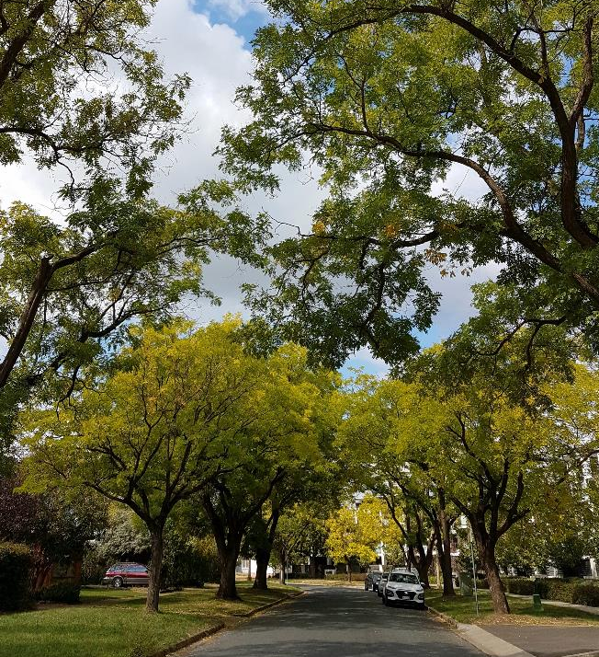
Questions?
Notes:
We now have some time for questions.
So please feel free to ask any questions you may have about the legislation and its implementation.
We will be passing this feedback onto the Urban Treescapes team and may need to refer some of your more detailed questions to them for follow-up.

Slide 20
Resources to support you
ACTmapi – check if a tree is on private or public land https://www.actmapi.act.gov.au/
Updated website information – www.act.gov.au/treeprotection
Tree Calculator – estimate replanting or financial contributions https://www.cityservices.act.gov.au/trees-and-nature/trees/canopy-cover
ACT Government Tree Protection Team – email us treeprotection@act.gov.au
Notes:
We also wanted to take this opportunity to mention there are a range of resources available to support you with this legislation transition.
Some of the resources we wanted to highlight are:
ACTmapi – check if a tree is on private or public land.
Tree calculator – remembering that this calculator will provide an estimate of the replanting or financial contribution amounts required if removal of a tree on a non-homeowners site is approved
Website information updated – we will have completed a comprehensive update of the tree page content on the City Services website to support industry and the community to understand the changes.
ACT Government Tree Protection Team – you can contact us via the email address shown on screen.

Slide 21
Thank you

